Slide 1
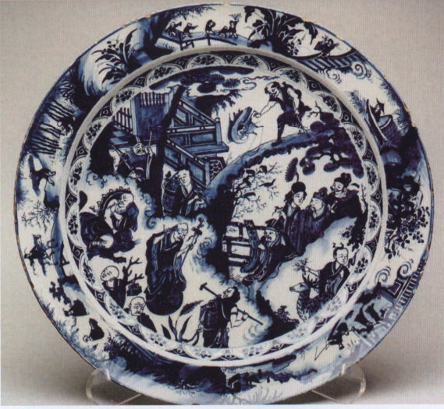
School for Smoking
劉孟欣
黃莉亞
徐敏勤
陳韻如

Slide 2
Introduction of the plate
Manufactured in Delft around the end of seventeen century.
Faux-Chinese style
Why they knew this plate
was not real Chinese porcelain?

Slide 3
The clay must be European
The glaze lacks the hardness and evenness of Jingdezhen ware
The patterns on the plate
1. Three- character inscription on the tablet were carried by a Confucian official in the middle of the plate
2. A bald immortals sucked fiercely on a long-stemmed pipe.

Slide 4
At that time, the Chineses were
no possible to depict a character
that would smoke on their
repertoire, but why the European
would know that Chinese would
smoke?
They had heard that Chinese smoked.
Some bit of global information had come
to Europe.
But, when did the Chinese start to
smoke?

Slide 5
17th Century :楊士聰《玉堂薈記》
This book revealed what the life was like in Beijing in the closing decades of Ming when times were still good.
Observed two minor changes:
1. Peddlers were selling wild grouse which did not belong in the Beijing area.
- Why the wild grouse came?
(1) Military maneuvers
(2) A weather change
2. The world was topsy-turvy with the appearance of tobacconists.

Slide 6
Why did the tobacconists appear?
Soldiers smoked.
Farmers started to plant tobacco.
The Beijing residents picked up the habit of smoking.
The demand for tobacco aroused.
The tobacconists appeared.

Slide 7
The ban of the tobacco
Why?
(1) Official explanation: a waste of time, health, and money.
(2) Local people: an overreaction to a pun.
吃煙
吃燕(京城舊名)
推翻政府

Slide 8
America’s indigen: tobacco
Tobacco’s uses to the native Americans
(1) Communicate with the spirits.
(2) An analgesic medicine
(3) As a gift to ask for a favor or return thanks.
Transmit to the worldwide along with the web of trade
Causing the transculturation

Slide 9
Religious realm
Medicine
Medium of sociability
Europe,
America
China

Slide 10
All for the profits.
The profitable solution in the long run was to control both supply and quality at the source.
This the Europeans accomplished by pushing aside Native producers in the Americas and setting up tobacco plantations.

Slide 11
After tobacco became a commercial crop.
Tobacco farmers found that they needed more labor than their own families could.
Indians in South America were unwilling to work on tobacco plantation and slipped away at night.

Slide 12
The establishment of WIC.
The solution was to find people who had no choice but to do the work- slaves.
The WIC secured positions on both sides of the south Atlantic, buying slaves in Africa and selling them to tobacco plantation owners in the Caribbean and Brazil.

Slide 13
A new system of trade-Triangle Trade.

Slide 14
The reason why Europe dominate the globe.
Together three prime commodities of the age- silver, tobacco, and slaves to mine first and harvest the second- set the foundation on which the long-term colonization of the Americas rested.
This sort of transnational arrangement, which gradually incorporated other commodities as well.

Slide 15
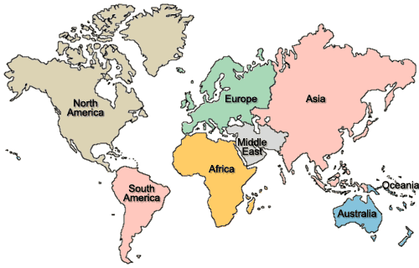
Tobacco Traveled to China by Three Routes
Port.
Spain
Mexico
Macao
Manila
Brazil
Eastward route
Westward route

Slide 16
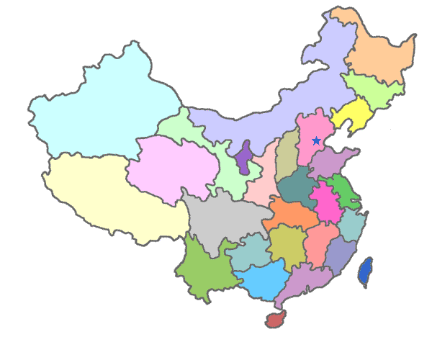
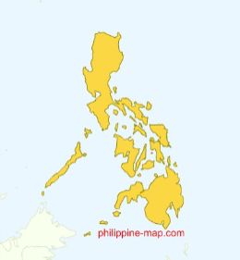
Fujian
Guangdong
Macao
Manila

Slide 17
The Three Routes
I. Eastward Portuguese Route:
Portuguese
Brazil
Guangdong
Macao
Spain
Mexico
Fujian
Manila
II. Westward Spanish Route:
III. Consisted of a series of hops around East Asia to Beijing

Slide 18
Fujian gained the reputation as the home of tobacco in China
The ships coming from Manila arrived into several ports in
China, and the most important port was Moon Harbor,
which was at the south end of the Fujian coast.
“ It gradually spread within all our borders, so that
everyone now carries a long pipe and swallows the smoke
after lighting it with the fire. Some have become drunken
addicts.”

Slide 19
Tobacco reached to Shanghai from Fujian in the 1630s
The habit of smoking worked its way into the interior of
Fujian and up the maritime coast, finally reached to
Shanghai in the 1630s.
In the 1639 ban on cultivation of tobacco in Beijing was
forced in Shanghai as well.
Because only bandits consume it to ward off the cold and
damp, so people were not allowed to grow or sell it.
The prohibition had its effects at the beginning; however,
soldiers were all smoking tobacco and peddlers were
selling it again within a few years.

Slide 20
The Third Route
The First Step: The empire of the Portuguese stretching from
Brazil through India and up to Japan.
Korea
Manchuria
Macao
Japan (Nagasaki)
Japan
Korea
The Second Step: the regional trading network of the Japanese into Korea.
The Third Step: the circuit of exchange within Korea that circulated
goods up to Manchuria.
Manchuria
Northeast China (Beijing)
The Final Step: The cross-border trade between Manchuria and China

Slide 21
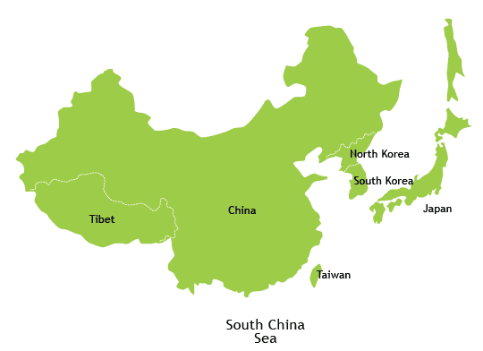
Manchuria
4.
Beijing
3.
2.
Nagasaki
1.
Macao

Slide 22
Why the third route took a long way around East Asia to Beijing? & Why the smoking has to do with the Manchu threat on the border?

Slide 23
Because of the bandits, the Ming Dynasty prohibited free
trade and to grow or sell tobacco.
Therefore, tobacco was brought into Manchuria through a
more complicated route, which took a long way around East
Asia to Beijing.
Beijing residents picked up the smoking habit brought by the
soldiers who were moved north to against the Manchus.
Enabled the Manchus, thanks to their hugely profitable
business in tobacco and other commodities such as gold and
Ginseng, to finance their eventual conquest of China in 1644.

Slide 24
How to find a legitimate cultural niche in Chinese for tobacco ? Tobacco could have a place in Chinese medicine!
According to Yao Lu, Fang Yizhi and Zang Jiebin, it have following property of a medicine:
Blocking malarial vapors.
Getting rid of head lice.
Dispelling dampness.
Removing congestion.
Warming internal organs
Speeding circulation.
! But if you overdo it, the heat can make you sick.

Slide 25
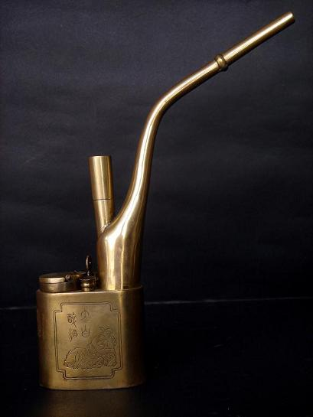
After the ban became a dead letter, everyone in China started smoking.
Yang(陽) Ying(陰)
To reduce the yang of tobacco smoke, they came up with two solution:
Drawing the smoke through
pipes with longer stem.
Cooling the smoke by passing
it through water(ying).
water pipe or hookah

Slide 26
How smoking made gentleman a gentleman?
They construed their taste for tobacco differently was to treat the compulsion to smoke as a sign of true gentleman.
Addition was not a physical shortcoming, but the sign of a passionate mind.
yanke (菸客)
Many poems were written to enlist and praise the good sense of smoking.

Slide 27
Opium appears
Tobacco merged in opium madak
Madak was delivered into China by the Dutch from Taiwan.
English traders brought opium from India to China to reverse the trade deficit that came from buying so much tea.
A troubling transculturation.

Slide 28
The romance of opium has long since disappeared
Now, though smokers can today still be counted in the hundreds of millions worldwide, the sentiment toward tobacco had no longer existed.
However, the effect(transculturation) tobacco bought worldwide have changed the globe profoundly.

